Slide 1
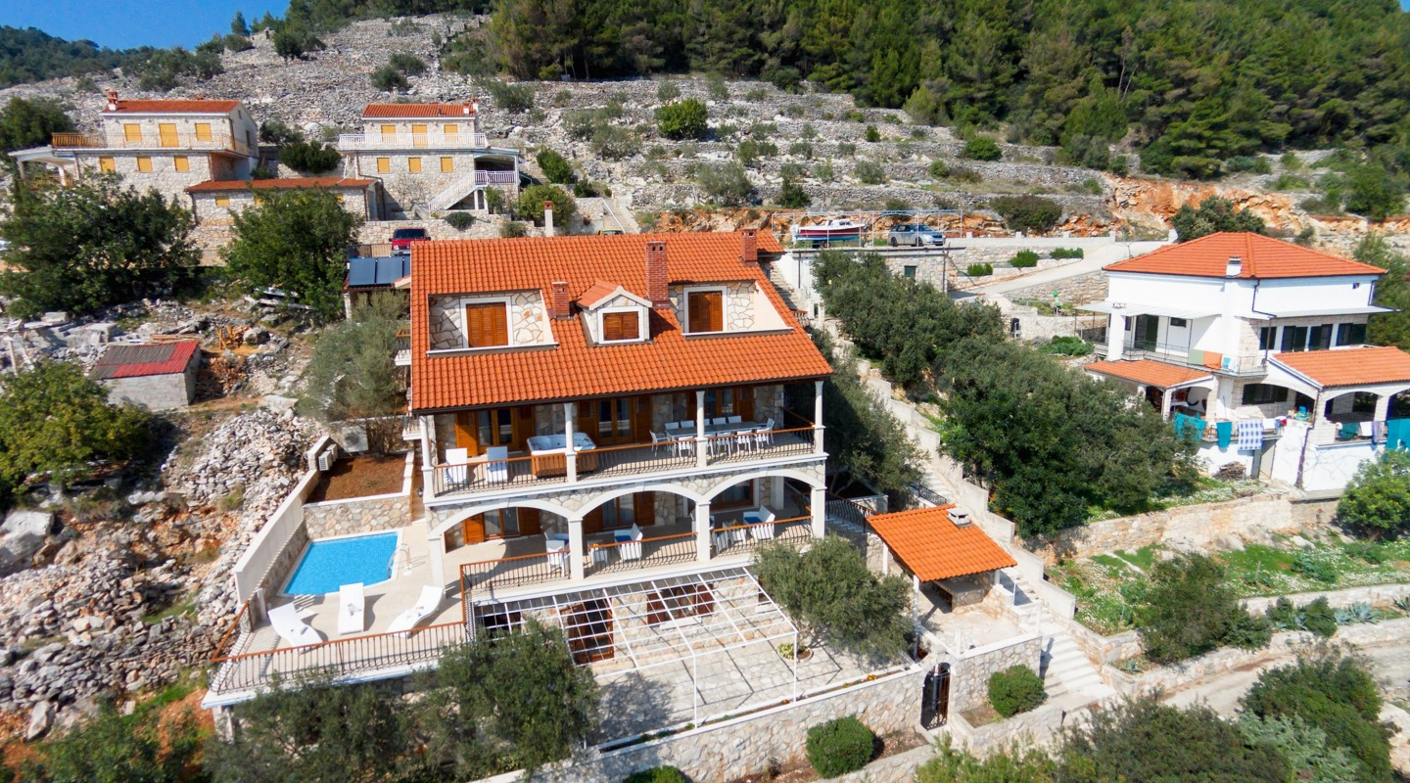
VILA
by Leonidas
6 rooms / Number of guests 12
Sea / cove view
Location / sea 8 m / pebble beach 150 m / restaurants 350 m

Slide 2
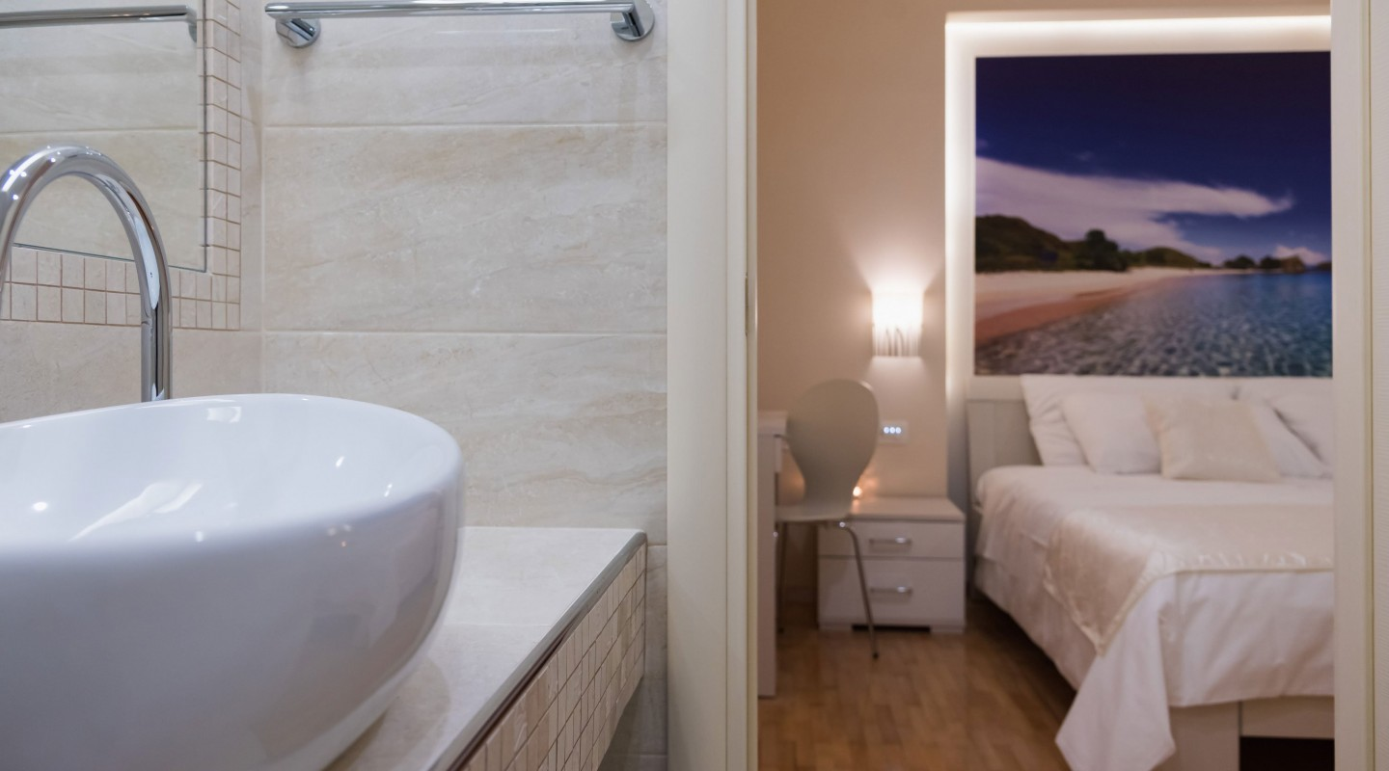
ROOMS
6 bedrooms with en suite bathrooms / 2 kitchens
1 dining area / 1 living room with fireplace

Slide 3
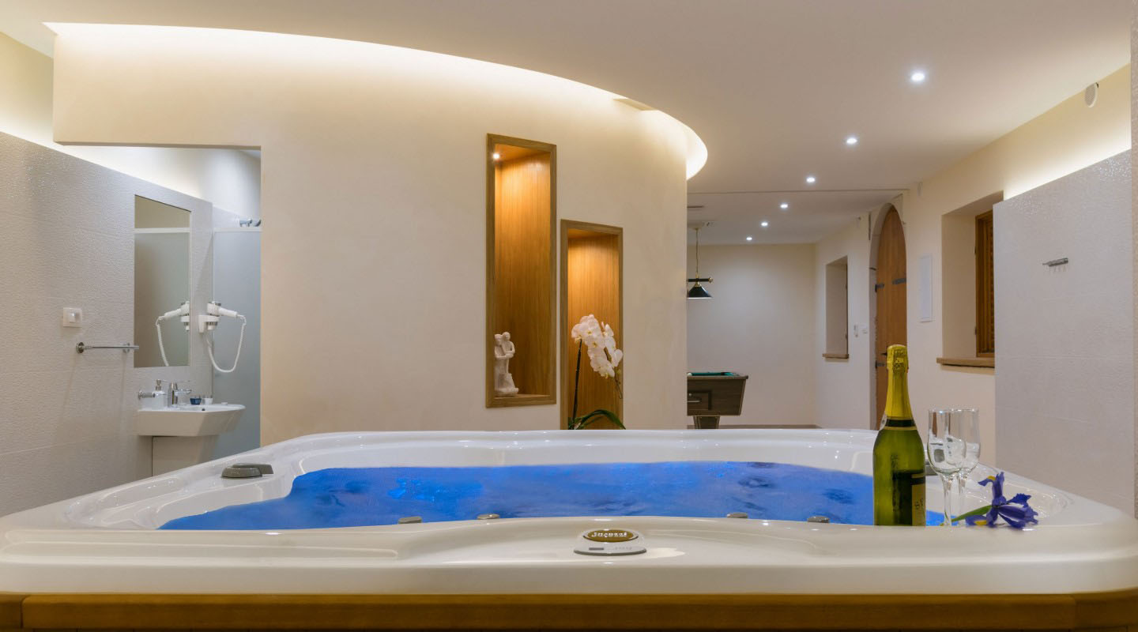
COMFORT
Air condition / wellness / outdoor terrace with sundecks
Heated swimming pool with plateau / 2 outdoor jacuzzis / sauna

Slide 4
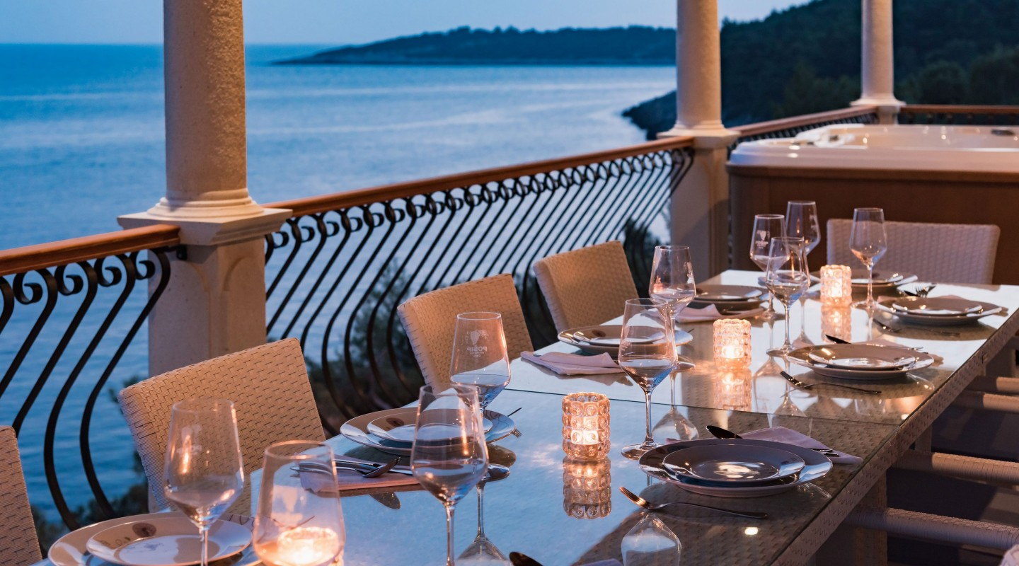
ENTERTAINMENT
1 Billiar table / heated swimming pool / terrace with garniture
Outdoor barbecue / SAT LCD TV / Internet access /

Slide 5
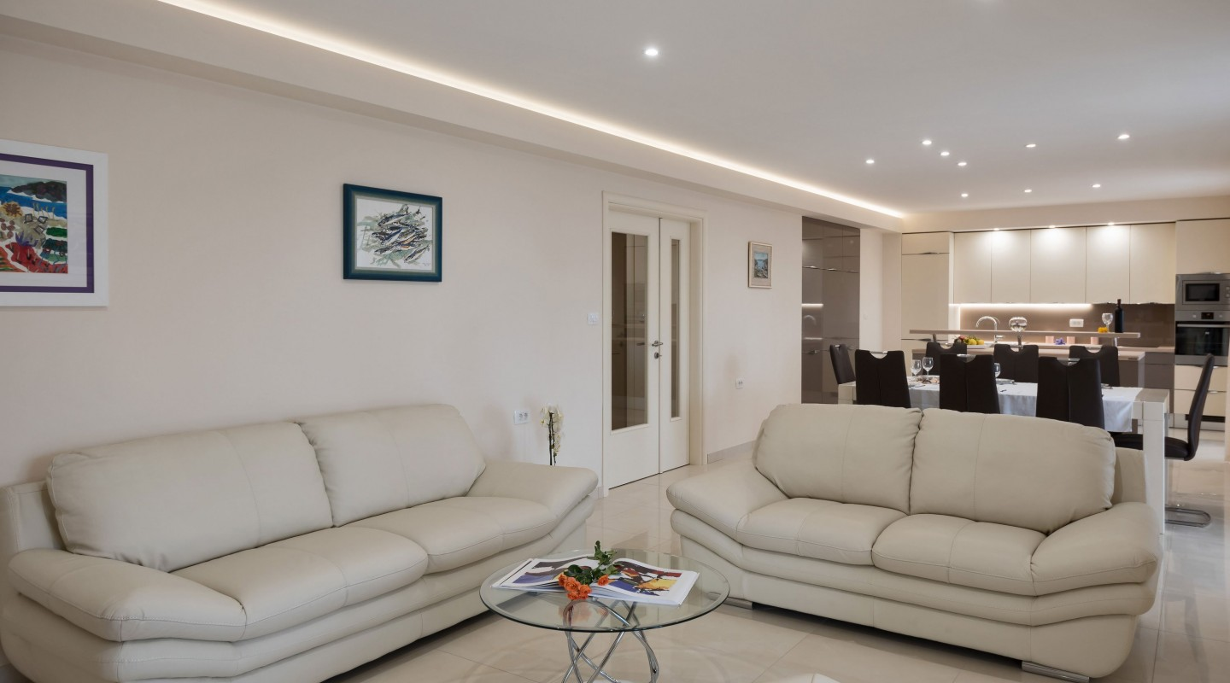
EQUIPMENT
Internet access / 2 fully equipped kitchens / 1 billiar table
Sauna / wellness / plateau by the pool / sundecks / indoor fireplace
Outdoor barbecue / 2 washing machines / 4 parking places

Slide 6
DISTANCES
The center of village Grscica 350 m and Blato 7 km
Sea 8 m / restaurants 350 m / grocery shop 2 km

Slide 7
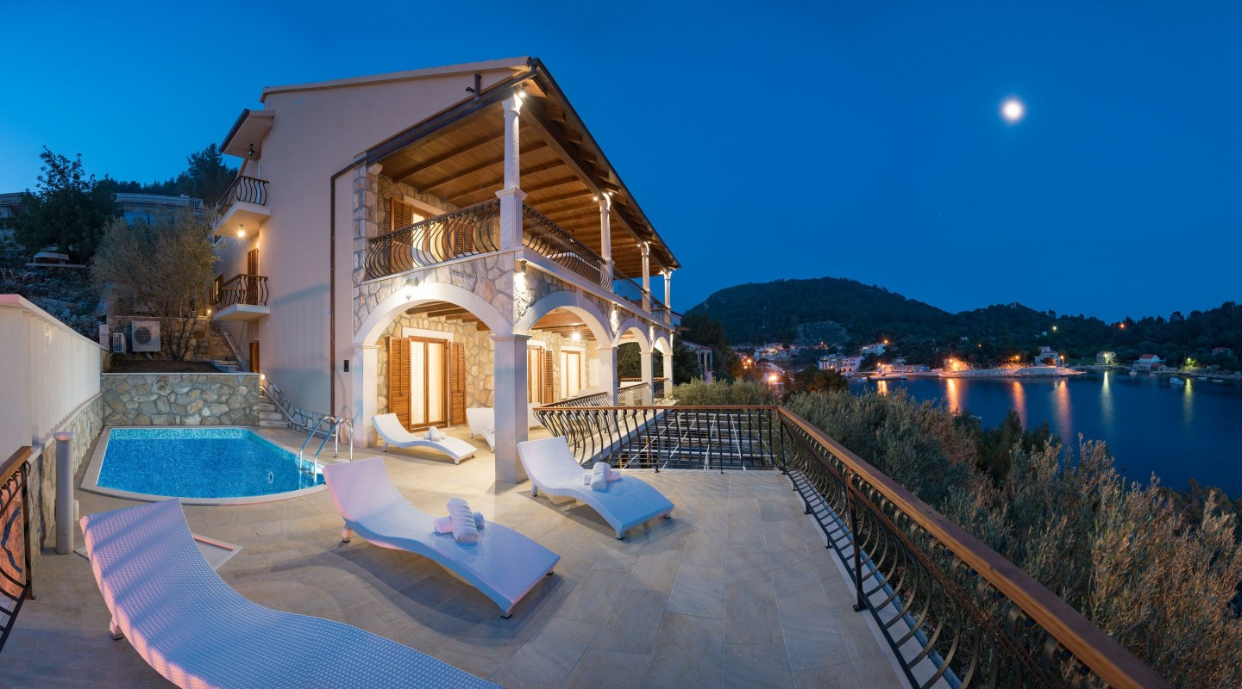
VILLA MAGIC
Villa Magic is situated in the peacful cove of Grscica on the island of Korcula.
Villa has 4 floors with 6 rooms, heated swimming pool, sauna and wellness.
Inside the Villa are 2 kitchens, living room with fireplace and dining area.
Villa has beautiful terraces with seaviews and garniture and by the pool are sundecks.
You can use Internet, watch satellite TV or play billiar. Villa has 4 parking places.
Distace from the sea is 8 m, and from the center of villafe Grscica 350 m.

